Slide 1

Producing Submission-Quality TFLs
Directly from R
Yusi Liu , Kaiping Yang
RUG 2026

Slide 2
Disclaimer
The content, ideas and conclusions presented in this presentation are solely those of the authors and do not necessarily represent or reflect the views, policies, or official positions of BeOne Medicines. While every effort has been made to ensure the accuracy and reliability of the information provided, BeOne Medicines does not endorse or assume responsibility for any statements, interpretations or recommendations made herein. The material is intended for informational purposes only and should not be construed as official opinion or guidance of BeOne Medicines.

Slide 3
Agenda
Background: R in Clinical Trials Submissions
Part I: Tables & Listings (flextable, rtables, r2rtf)
Part II: Figure Outputs (RTF, DOCX, PDF)
Part III: Download All
Part IV: R Package Validation

Slide 4
Background:
R in Clinical Trials

Slide 5
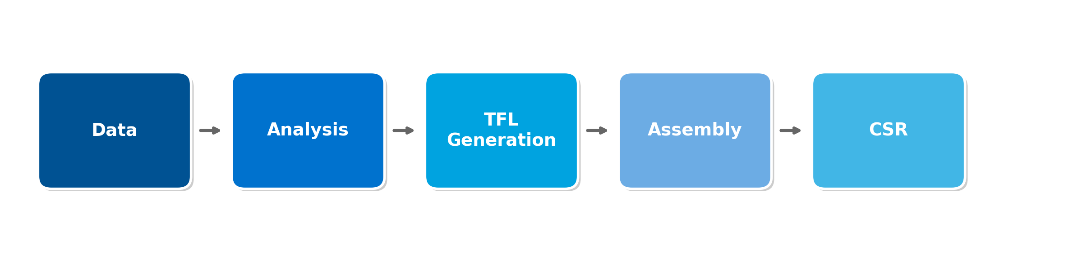
Why This Matters
CSRs require large numbers of TFLs with strict formatting
SAS has been the traditional standard
R is now increasingly used for regulated and submission-related work
The practical question is no longer "Can R do it?" but "How do we make outputs submission-ready?"

Slide 6
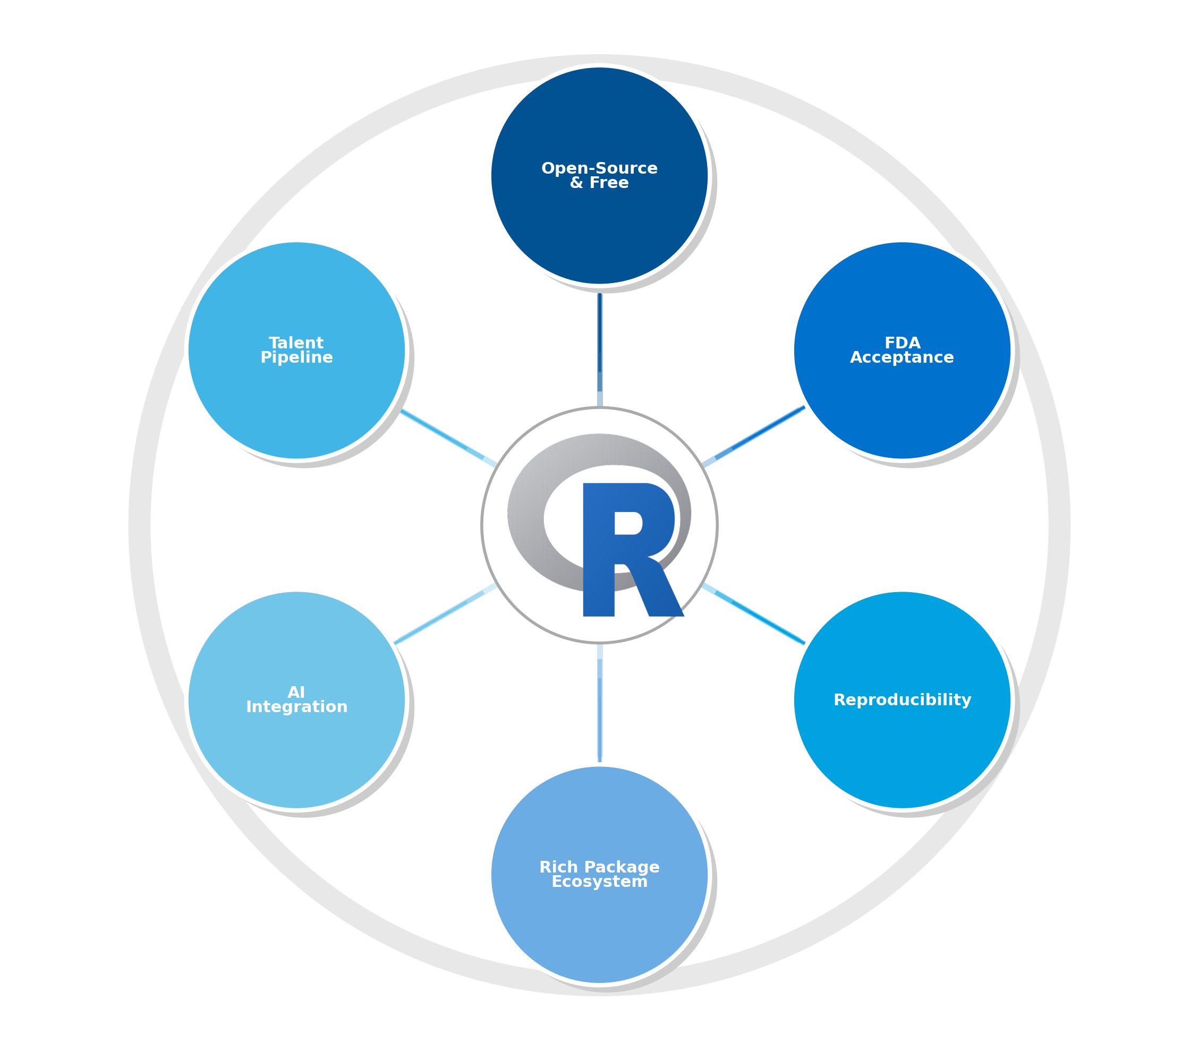
Why R for TFLs?
1. Open-Source & Free
No licensing costs; transparent codebase for regulatory inspection
2. FDA Acceptance
FDA has accepted R-based submissions; R Consortium engaging regulators
3. Reproducibility
Code-based workflows enable exact replication; version control tracks changes
4. Rich Package Ecosystem
Specialized packages: rtables, r2rtf, flextable, admiral, pharmaverse
5. Easy for AI Integration
R's open ecosystem enables seamless AI/ML tool integration
6. Talent Pipeline
Universities teach R extensively; easier to recruit skilled professionals

Slide 7
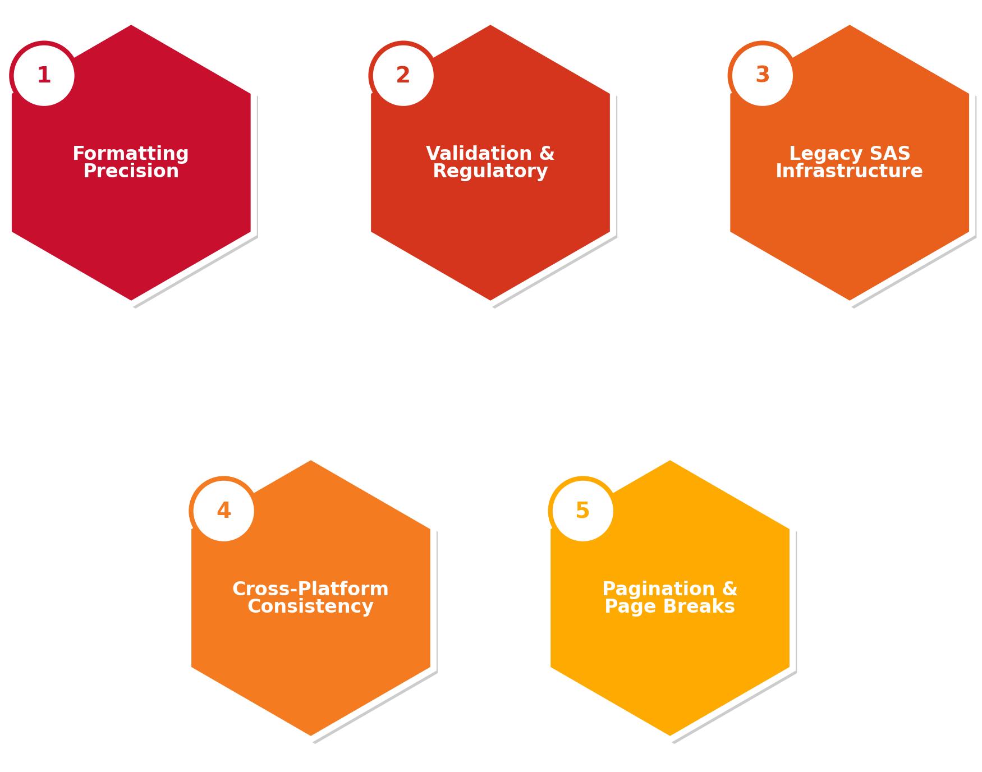
Challenges of Using R for TFL Submissions
1. Formatting Precision
Exact fonts, alignment, pagination, column widths matching templates
2. Validation & Regulatory
R packages require validation documentation for regulators
3. Legacy SAS Infrastructure
Decades of SAS macros and workflows to transition
4. Cross-Platform Consistency
Outputs must look identical across systems and Word versions
5. Pagination & Page Breaks
Controlling breaks, repeating headers, keeping records together

Slide 8
Part I:
Tables & Listings

Slide 9
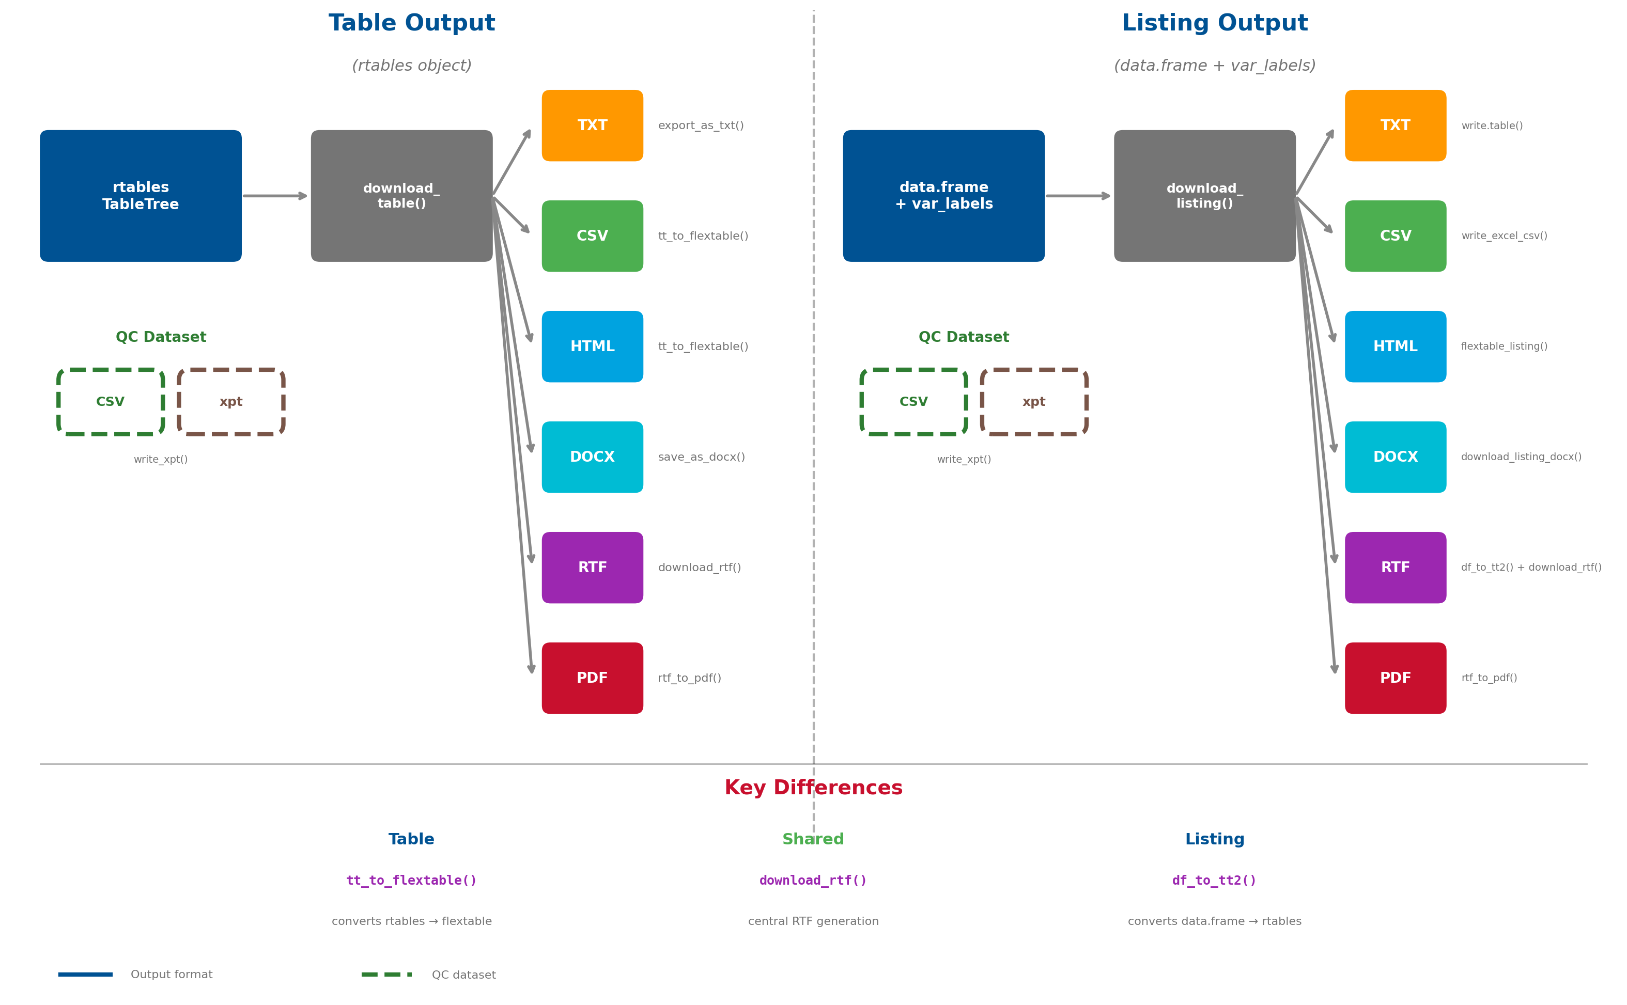
Overview of Table & Listing Output

Slide 10
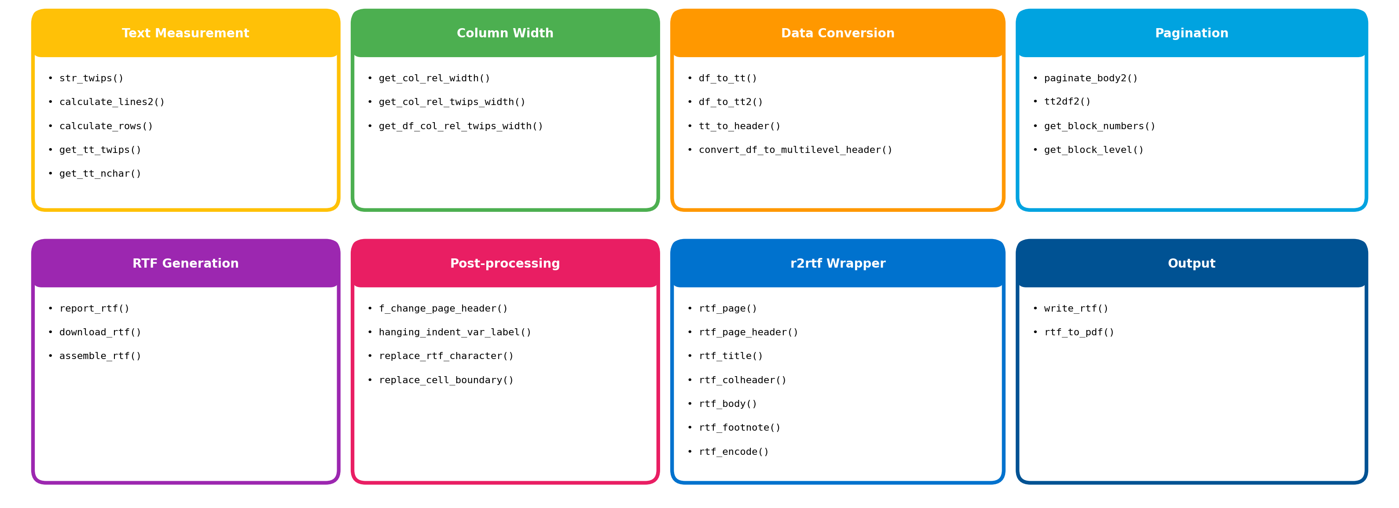
Detailed Function Summary

Slide 11

Key Technical Ideas
str_twips(text, font_size)
Calculates text width in twips (1/1440 inch) using font lookup table for Times New Roman. Essential for precise column width calculation.
calculate_lines2(text, max_width, font_size)
Calculates number of lines needed to display text within a specific width. Handles word wrapping, long word truncation, and newline characters.
calculate_rows(text, max_width)
Similar to calculate_lines2, calculates rows needed for text display.
get_col_rel_width()
Calculates relative column widths in character units. Balances label column vs data columns using recursive algorithm.
get_col_rel_twips_width()
Same as above but returns widths in twips for precise RTF formatting. Uses 1440 twips = 1 inch.
get_df_col_rel_twips_width()
Calculates optimal widths based on actual content. Applies min (1100) and max (4000) twips constraints. Handles compression when content exceeds available width.

Slide 12
Key Technical Ideas
Paginate_body2 (tt, title, footnote, ...)
Main pagination function. Calculates line heights for each cell, determines page breaks based on lpp (lines per page). Handles appendix vs intext placement differently
Tt2df2 (tt, title, footnote, ...)
Converts rtables to paginated data frames. Handles column splitting across pages. Creates header and body data for each page.
get_block_numbers(x)
Assigns hierarchical block numbers (1, 1.1, 1.2, 2, etc.) based on indentation levels for proper table grouping.
download_rtf (tt, path, study, title, footnote ...)
Main entry point for RTF generation. Orchestrates pagination, handles column splitting, uses parallel processing (mclapply) for multiple pages, calls assemble_rtf() to combine.
report_rtf (data, header, path, ...)
Core RTF generation using r2rtf package. Sets page layout (margins, orientation), adds page header with study ID and page numbers, title, column headers, body, and footnotes.
Other details: https://beigeneo365apc-my.sharepoint.com/personal/yusi_liu_beigene_com/Documents/Desktop/RUG-2026/download_TFL_function_usage.html

Slide 13
Part II:
Figure Outputs

Slide 14
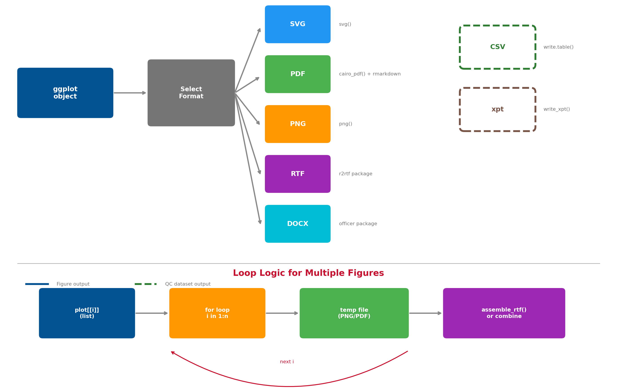
Overview of Figure Output

Slide 15
Code Illustrate
Figure Output Formats:
• SVG: svg() → print() → dev.off()
• PDF: cairo_pdf() + rmarkdown::render()
• PNG: png() → print() → dev.off()
• RTF: r2rtf package
• DOCX: officer package
QC Dataset Downloads:
• CSV: write.table()
• xpt: write_xpt()
Loop for Multiple Figures:
for(i in 1:length(plot)) {
temp[i] <- export(plot[[i]])
}
assemble_rtf(temp, output)

Slide 16
SVG & PNG
SVG Output - Vector Graphics for Web
PNG Output - Raster Graphics for Presentations
Scalable Vector Graphics - perfect for web display and infinite scaling
Portable Network Graphics - fixed resolution bitmap for presentations and documents
# SVG Output if (file_format == ".svg") { svg(file, height = 15, width = 20) # Open SVG device print(plot) # Render plot to device dev.off() # Close device and write file }
# PNG Output for (i in 1:length(plot)) { temp_path[i] <- paste(temp_dir, paste0(i, "_plot_temp.png"), sep = "/") png(temp_path[i], width = 1280, height = 640) # Open PNG device (HD resolution) print(plot[[i]]) # Render plot dev.off() # Close device }
Key Functions:
Key Functions:
svg(filename, height, width) - grDevices base R function
png(filename, width, height) - grDevices base R function
print(plot) - Renders ggplot object to current device
Resolution: 1280x640 pixels (HD aspect ratio)
dev.off() - Closes graphics device and finalizes file
Loop Logic:
Advantages:
- Iterates through plot list for multiple figures
- Infinitely scalable without quality loss
- Creates unique temp file for each plot
- Small file size for simple graphics
- temp_path array stores all file paths for later use
- Editable in vector graphics software (Illustrator, Inkscape)

Slide 17
RTF & DOCX
RTF Output - r2rtf Package
DOCX Output - officer Package
# Step 1: Create PNG temp files first (same as PNG output) for (i in 1:length(plot)) { temp_path[i] <- paste(temp_dir, paste0(i, "_plot_temp.png"), sep = "/") png(temp_path[i], width = 1280, height = 640) print(plot[[i]]) dev.off() temp_path_rtf[i] <- paste(temp_dir, paste0(i, "_plot_temp.rtf"), sep = "/") }
# Create new Word document doc <- officer::read_docx() # Define text properties properties1 <- officer::fp_text(color = "black", font.size = 8, bold = FALSE, font.family = "Times New Roman") # Create formatted paragraphs study_id_par <- officer::fpar(officer::ftext(data_info$studyid, properties3)) phase_par <- officer::fpar(officer::ftext(data_info$phase_format, properties3)) title_par <- officer::fpar(officer::ftext(title, properties2)) footnote_par <- officer::fpar(officer::ftext(footnote, properties1))
# Step 2: r2rtf Pipeline for Each Figure for (i in 1:length(plot)) { temp_path[i] %>% rtf_read_figure() %>% rtf_page(orientation = "landscape", margin = c(1, 1, 1.2, 1, 1.2, 1)) %>% rtf_page_header(text = c(study, "Page \pagenumber of \pagefield"), text_justification = c("l", "r")) %>% rtf_title(title = title, text_format = "b") %>% rtf_footnote(footnote = c(fn1, fn2, fn3)) %>% rtf_figure(fig_height = 4.3, fig_width = 8) %>% rtf_encode(doc_type = "figure") %>% write_rtf(temp_path_rtf[i]) }
# Loop through plots and add to document for (i in 1:length(plot)) { doc <- doc %>% officer::body_add_fpar(value = study_id_par, style = "Normal") %>% officer::body_add_fpar(value = phase_par, style = "Normal") %>% officer::body_add_fpar(value = title_par, style = 'graphic title') %>% officer::body_add_gg(value = plot[[i]], style = "centered", width = 10, height = 5, scale = 0.6) %>% officer::body_add_fpar(value = footnote_par, style = "Normal") if (i != length(plot)) { doc <- doc %>% officer::body_add_break() } } print(doc, target = file)
# Step 3: Assemble all RTF pages into final document assemble_rtf(temp_path_rtf, file)

Slide 18
PDF
PDF Output - Publication Quality with R Markdown
Create Rmd file (format, font, page margins)
Uses cairo_pdf() + rmarkdown::render() for professional PDF generation
# Step 2: Create R Markdown template dynamically write_lines('--- output: pdf_document classoption: landscape params: title_output: null plot: null footnote_output: null --- ```{r} knitr::include_graphics(temp_path) ``` ', glue("{temp_dir}/test_plot.Rmd"))
# Step 1: Generate temp PDFs temp_dir <- tempdir() for (i in 1:length(plot)) { temp_path[i] <- paste0(temp_dir, "/temp_pdf_", i, ".pdf") cairo_pdf(file = temp_path[[i]], width = 18, height = 11) print(plot[[i]]) dev.off() }
Fill in parameters: title; footnote, etc.
# Step 3: Render with rmarkdown rmarkdown::render( input = glue("{temp_dir}/test_plot.Rmd"), output_format = "pdf_document", output_file = file, params = list(title_output = title, plot = plot, footnote_output = footnote_pdf) )

Slide 19
Part III:
Download All

Slide 20
Why Download All?
1
One-Click Generation
2
Consistency
3
Reproducibility
Generate all TFLs simultaneously instead of one-by-one
Same study info, format, and naming conventions across all outputs
R code (.R) and log files saved for each TFL
4
QC Support
5
Organized Package
6
Time Savings
QC datasets (.xpt) generated alongside outputs for validation
ZIP file with submission-ready folder structure
Critical during data cuts when all TFLs need regeneration

Slide 21
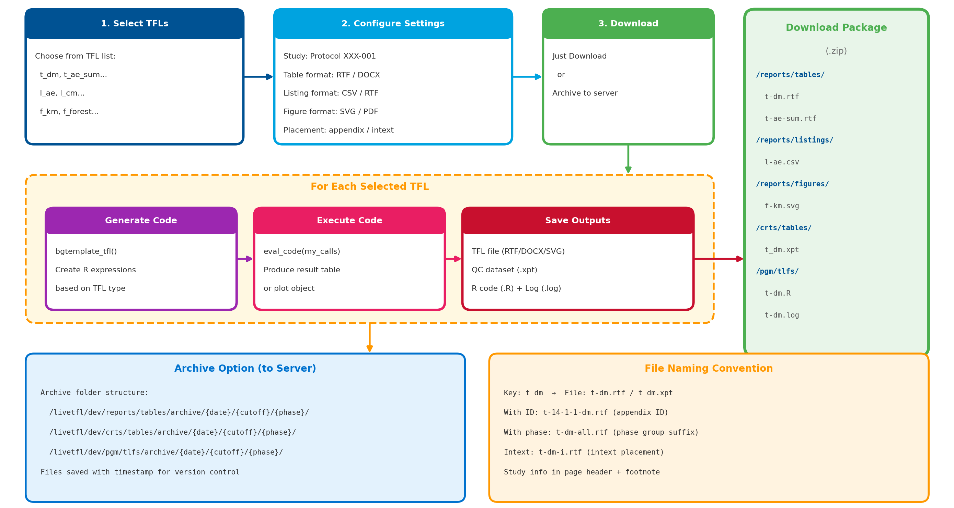
How ? Batch TFL Generation Workflow

Slide 22
Part IV:
R Package Validation

Slide 23
Why R Package Validation for Submissions?
Regulatory Requirements
• FDA 21 CFR Part 11
Electronic records must be trustworthy and reliable
• ICH E9 Guidelines
Statistical software must be validated
• Audit Trail
Evidence that software produces correct results
R-Specific Challenges
• Open Source
No formal QA; validation burden on user
• Frequent Updates
Version changes may alter behavior
• Dependencies
Bug in any dependency affects results
• No Vendor Support
No commercial guarantee of correctness
Risk Mitigation
• Reproducibility
Same code = same results across systems
• Accuracy
Verify against benchmarks or SAS
• Traceability
Document exact versions used
• Inspection Ready
Evidence of appropriate controls
Risk-Based Validation Approach
• High Risk: Statistical packages (e.g., survival, lme4) → Full validation with test cases
• Medium Risk: Data manipulation (e.g., dplyr, tidyr) → Functional testing
• Low Risk: Formatting/output (e.g., ggplot2, r2rtf) → Installation qualification
Reference: R Validation Hub (pharmaR.org) | FDA Statistical Software Clarifying Statement (2015)

Slide 24
R Package Validation: riskassessment
A Shiny application from R Validation Hub (pharmaR) for assessing R package risk
What It Does
• Collects risk metrics automatically
• Calculates risk scores for packages
• Provides review workflow for teams
• Generates validation documentation
• Stores assessment history in database
Risk Metrics Evaluated
• Maintenance: last update, # maintainers
• Community: downloads, reverse dependencies
• Testing: code coverage, test results
• Documentation: vignettes, examples
• License: open source compliance
Validation Workflow
Upload Package List
Auto-Collect Metrics
Calculate Risk Score
Team Review
Decision & Document
→
→
→
→
Source: R Validation Hub (pharmaR.org) | Uses riskmetric package for underlying calculations

Slide 25
riskassessment: Example Output
Package | Version | Risk Score | Risk Level | Decision | Reviewer
dplyr | 1.1.4 | 0.22 | Low | Approved | J. Smith
ggplot2 | 3.4.4 | 0.18 | Low | Approved | J. Smith
survival | 3.5-7 | 0.31 | Low | Approved | M. Chen
rtables | 0.6.5 | 0.45 | Medium | Approved | M. Chen
r2rtf | 1.1.1 | 0.52 | Medium | Approved | L. Wang
customPkg | 0.1.0 | 0.85 | High | Under Review | Pending
Risk Score Interpretation
Low Risk (0.0 - 0.3)
Minimal validation needed
Medium Risk (0.3 - 0.7)
Standard validation required
High Risk (0.7 - 1.0)
Full validation + testing
Benefits: Centralized tracking • Audit-ready documentation • Consistent risk criteria • Team collaboration

Slide 26
Summary

Slide 27
Key Takeaways
Background
Part I: Tables & Listings
Why R for TFLs?
- Open-source, FDA acceptance, reproducibility
- Rich package ecosystem, AI integration
Challenges
- Formatting precision, validation
- Legacy SAS infrastructure, pagination
Table & Listing output workflow
Key technical functions:
- str_twips(), calculate_lines2()
- paginate_body2(), download_rtf()
Twips-based width calculation
RTF generation with r2rtf package
Part II: Figure Outputs
Part III: Download All
Multiple output formats:
- SVG (scalable vector graphics)
- PNG (raster image)
- PDF (document format)
- RTF & DOCX (embedded figures)
Code examples for each format
Batch TFL generation workflow
Why Download All?
- One-click generation
- Consistency & reproducibility
- QC support & time savings
Organized package with folder structure
Part IV: R Package Validation
Why validation is needed | Risk-based approach | riskassessment package for automated risk scoring and documentation

Slide 28
Thanks!

